Slide 1





Smoother-based Orientation and Trajectory Estimation with Foot-mounted IMUs
Shilei Li, Dawei Shi, Yunjiang Lou,
Chenglong Fu, Lisheng Kuang, Ling Shi

Slide 2
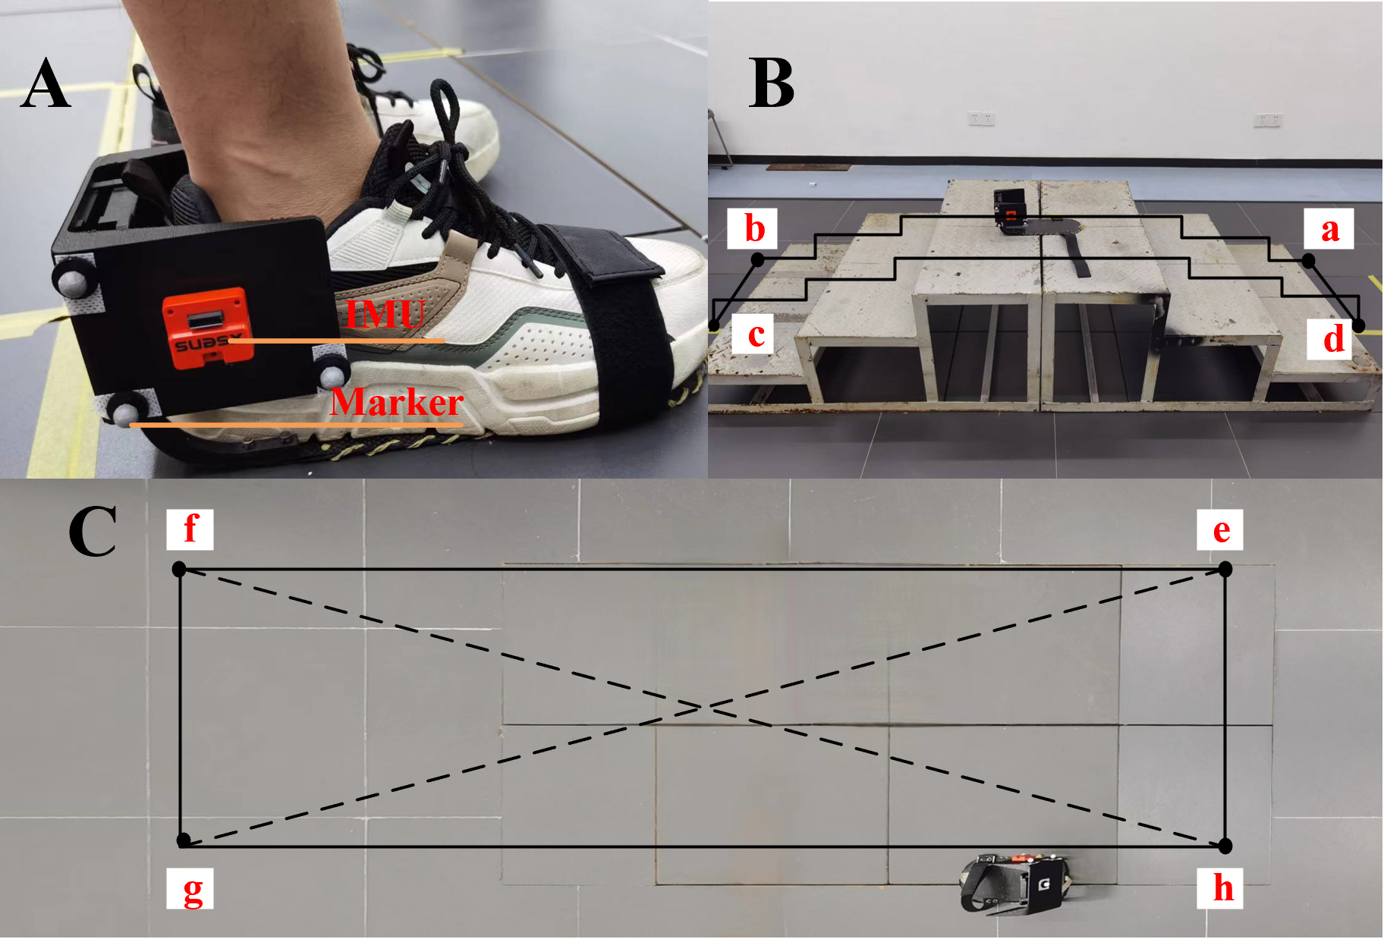
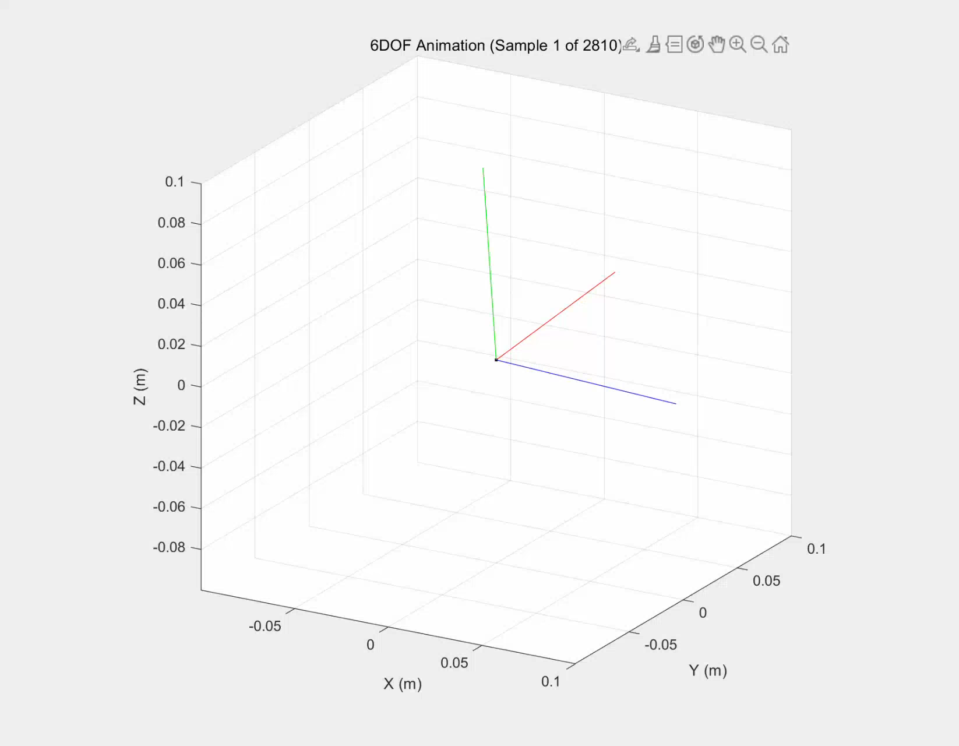
Walking Experiments with Optical Motion Capture System
Experimental setup
Square walking

Slide 3
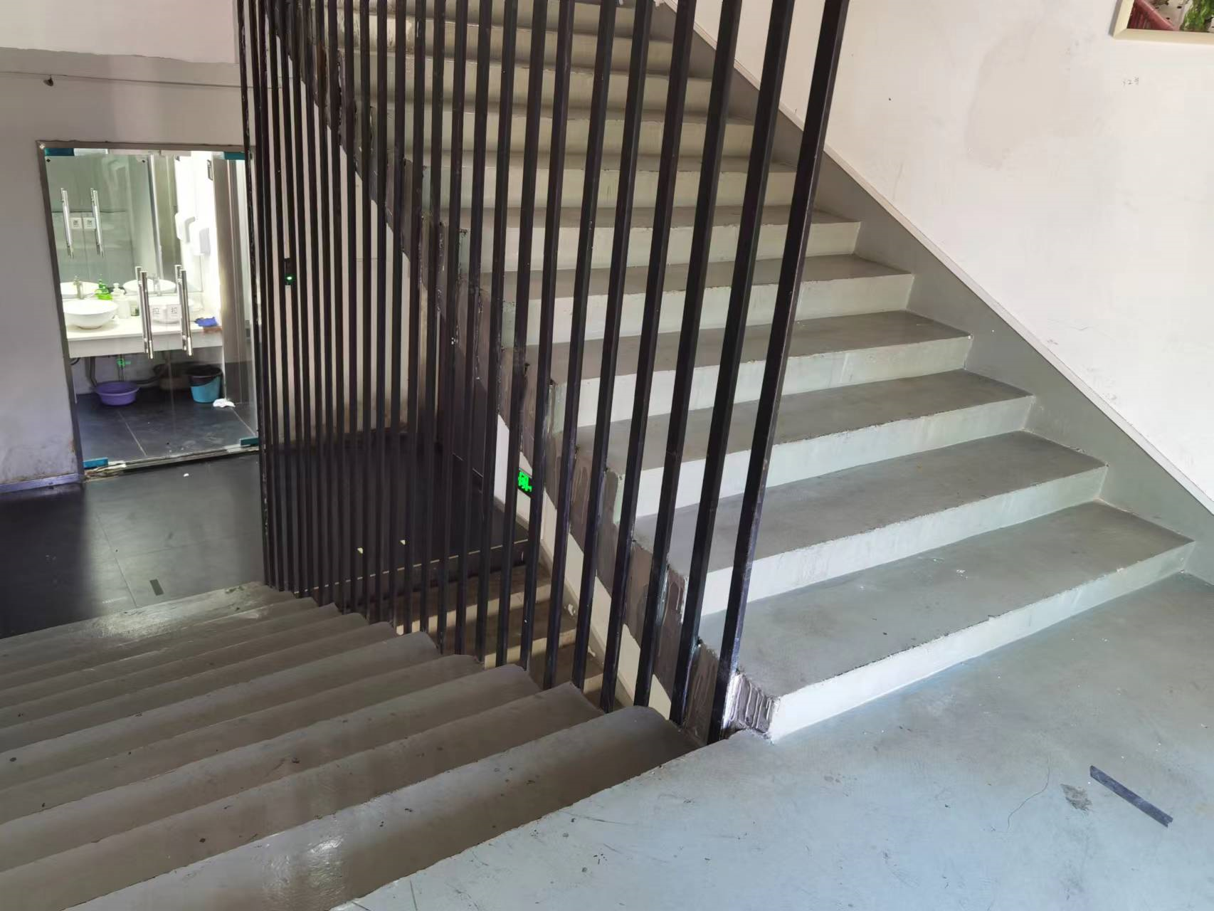
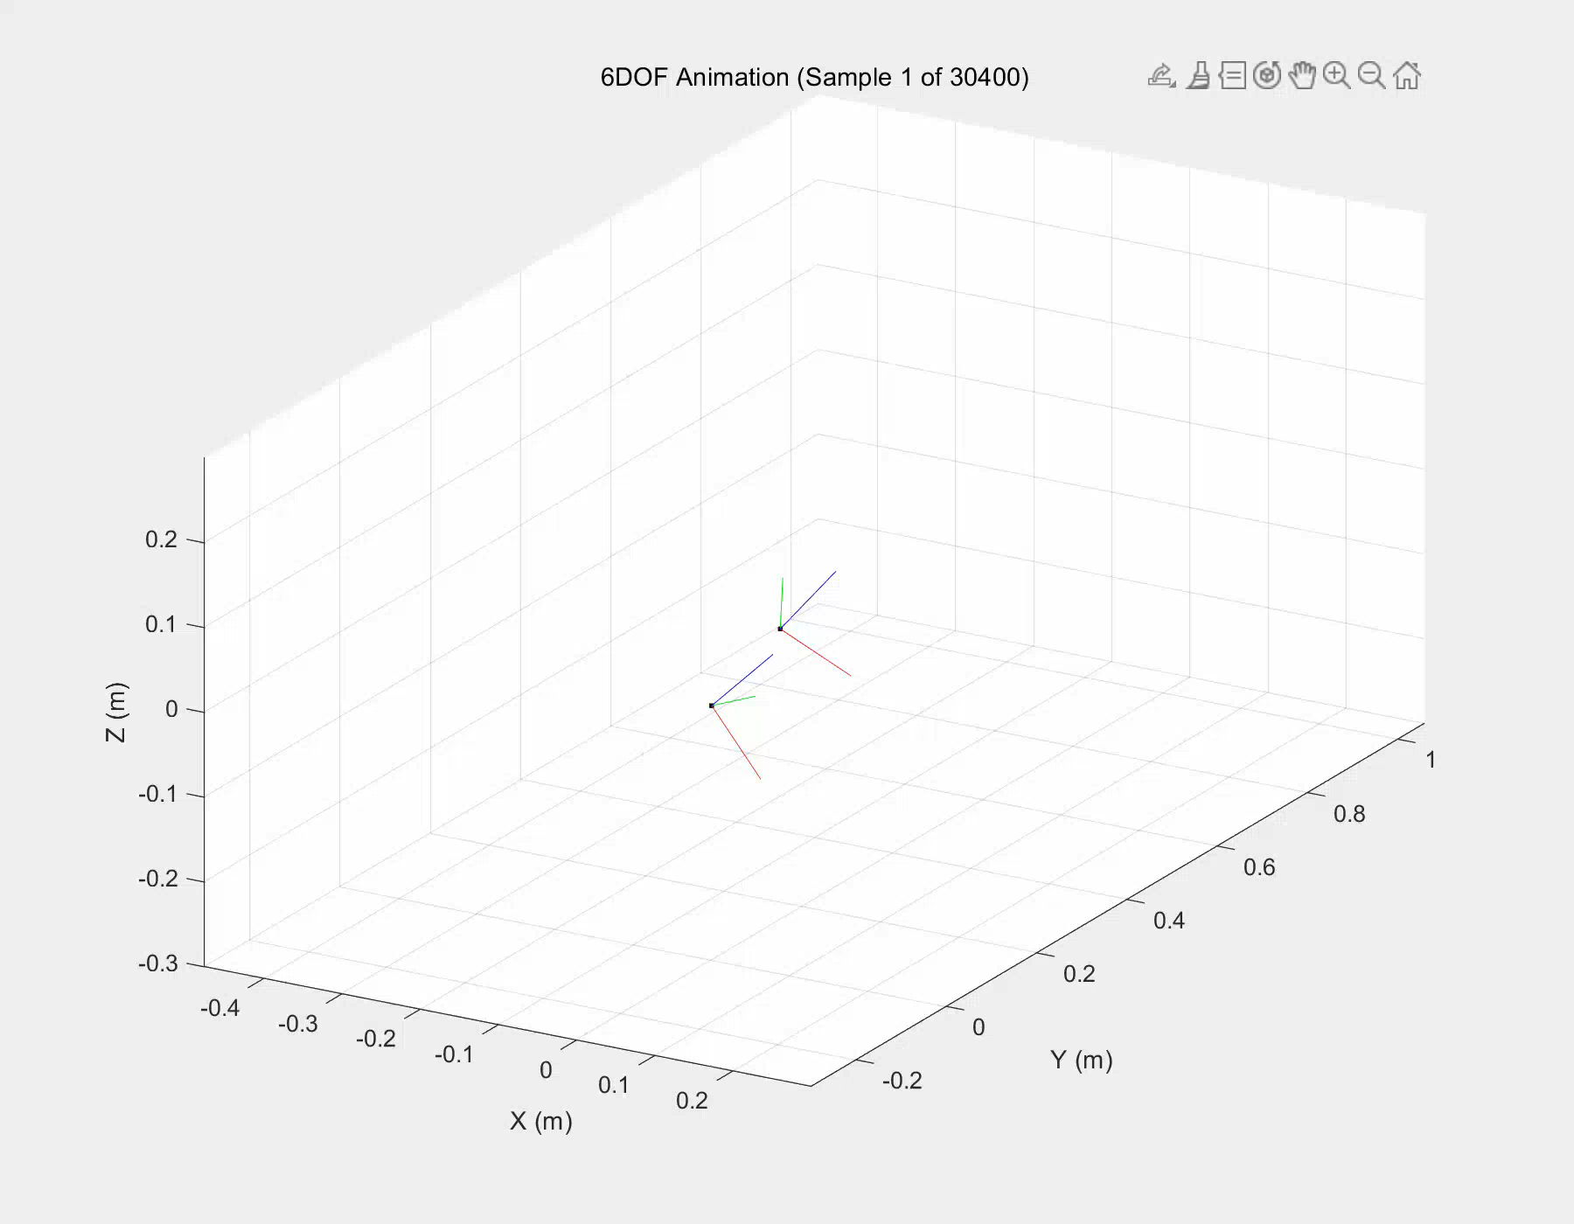
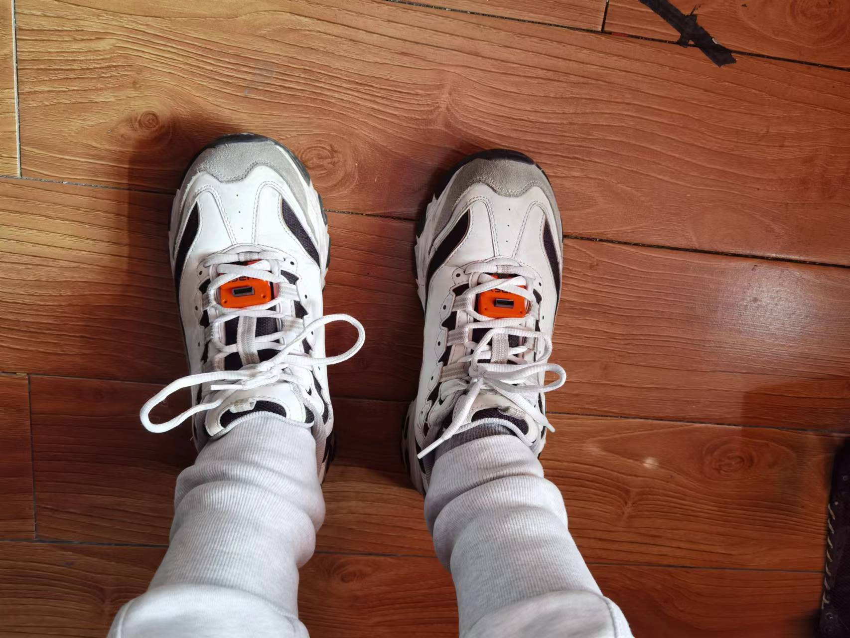
Stair Walking Animation
Ground truth stair height: 3.60m
Estimated stair height: 3.59m
Experimental setup
Foot orientation and trajectory animation

Slide 4
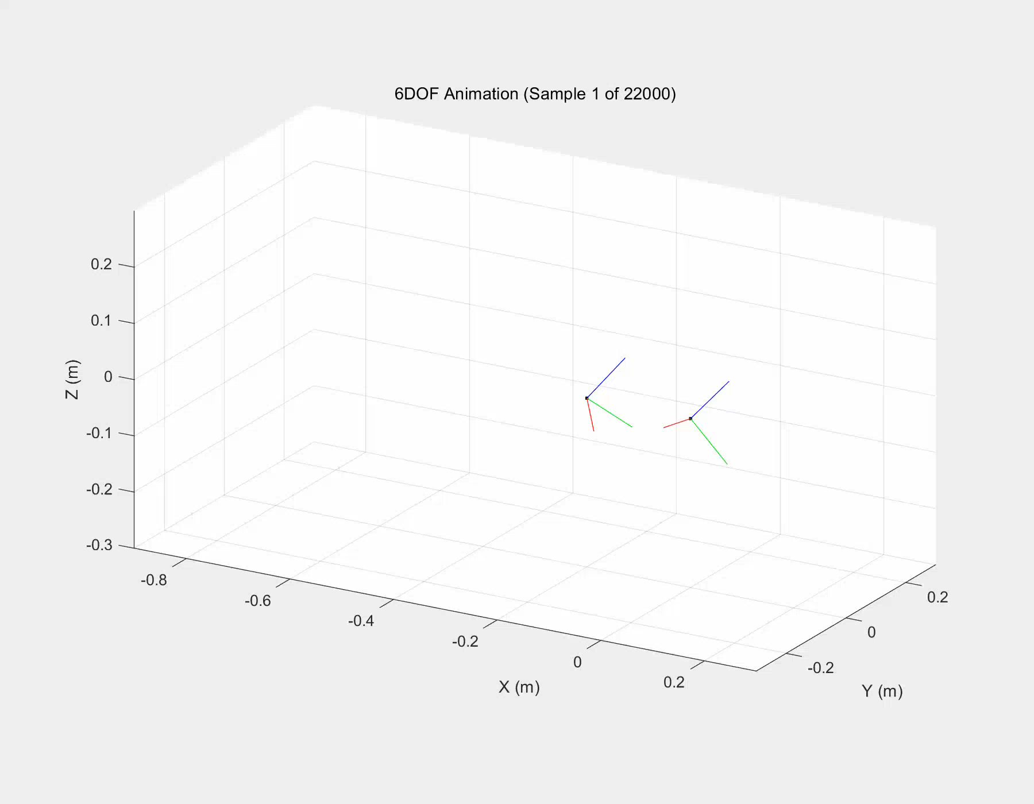
Indoor Walking Animation
Ground truth stair and slope height: 0.90m and 0.20m
Estimated stair and slope height: 0.92m and 0.21m
Experimental setup
Walking with stairs and slopes

Slide 5
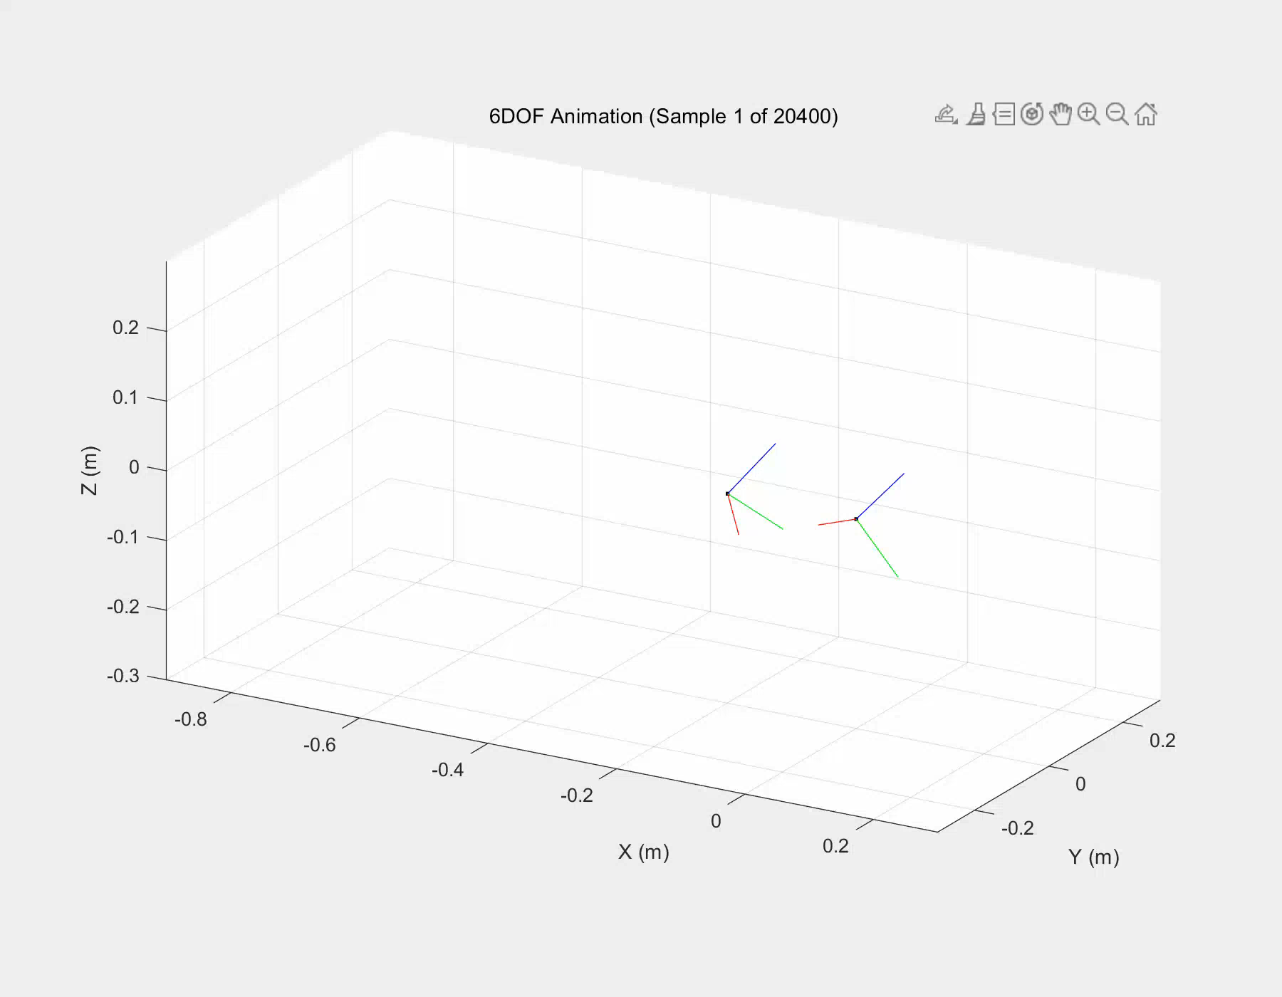
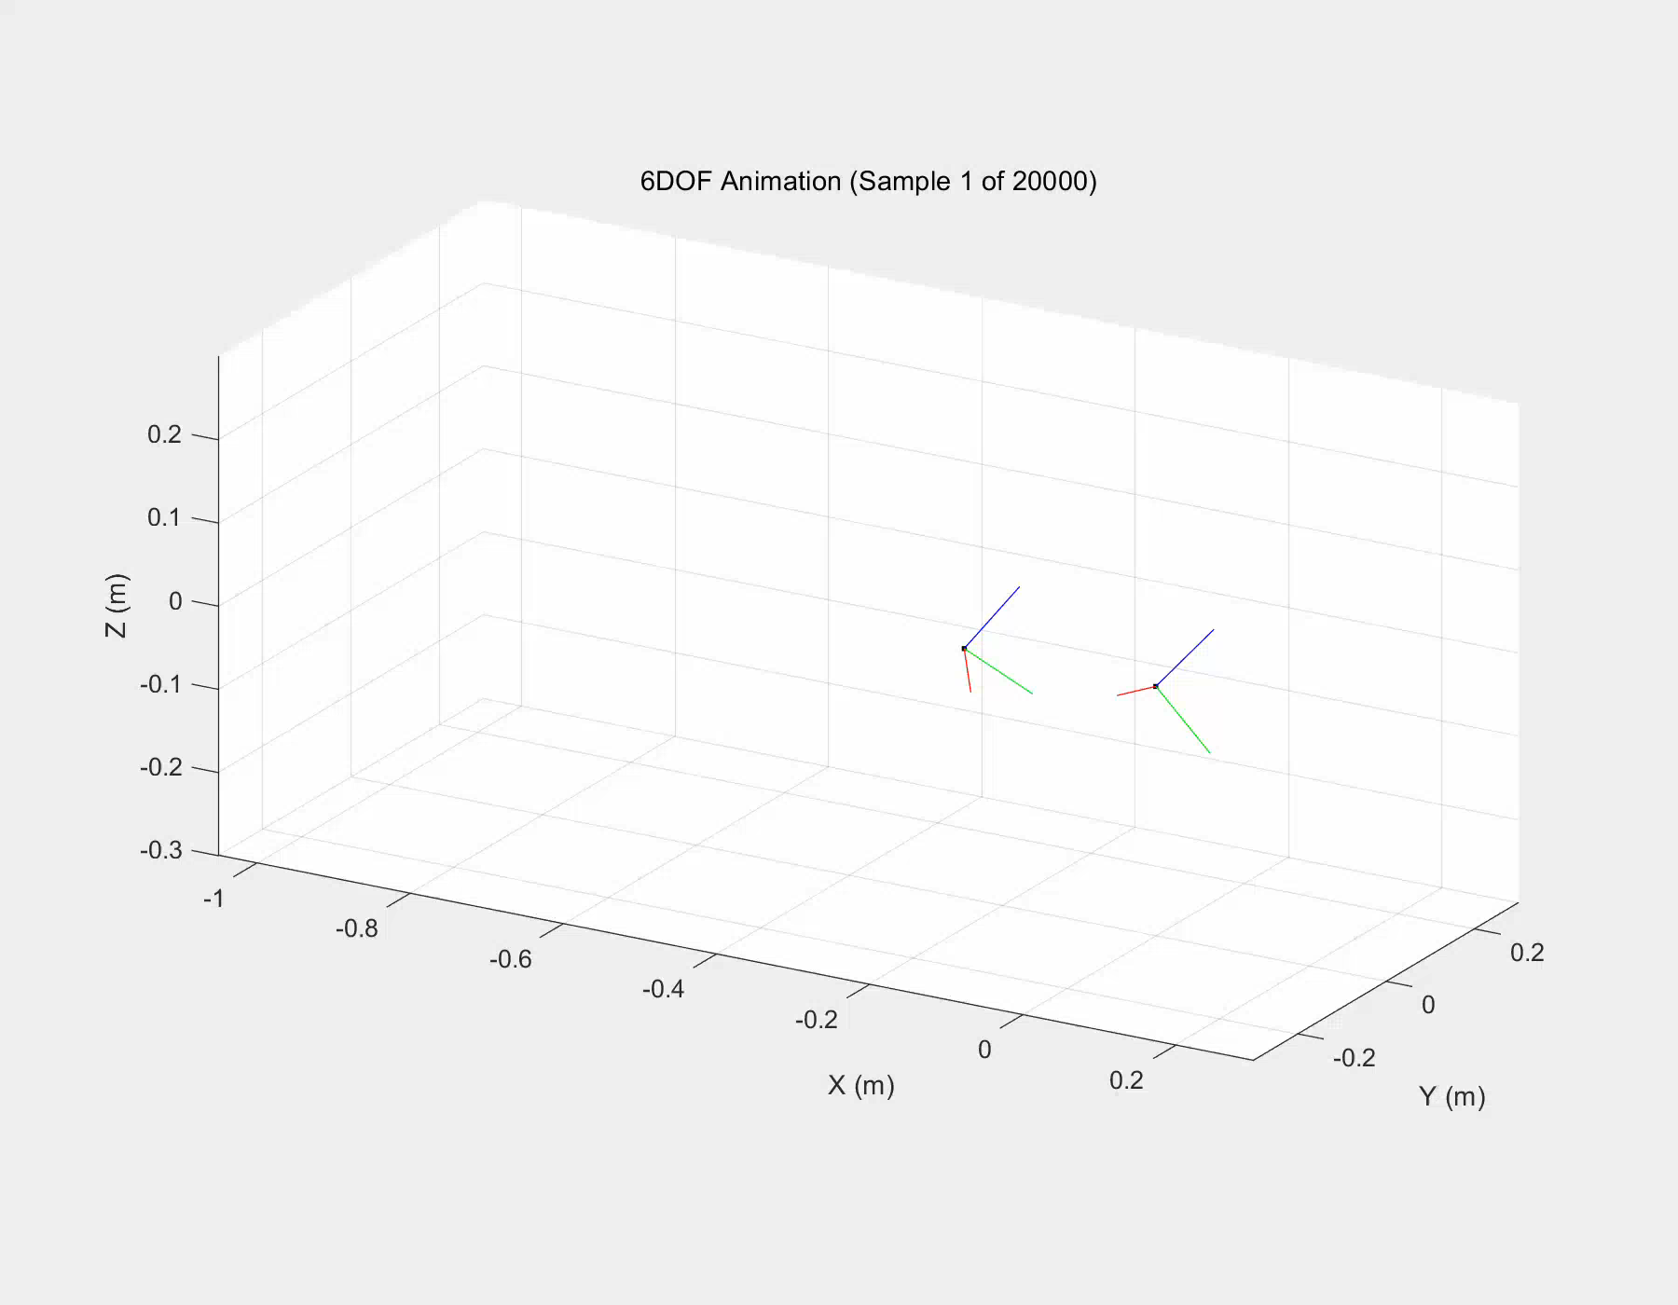
Indoor Walking Animation
Walking with stairs
Level walking

